Slide 1

Marketing Campaign Analytics report

Slide 2

Agenda
Executive Summary
Methodology
Results
Findings
Suggestions
Conclusion

Slide 3

Executive summary
In this data analysis project, I have conducted a comprehensive analysis on marketing campaign dataset containing 200000 records and 16 columns. The project involved rigorous data cleaning for generating a quality data and extensive exploratory data analysis of the dataset for in-depth hidden insights. Leveraged Power BI for visualization, my analysis revealed various critical insights into key performance indicators, trending campaign, campaign performance over time, engagement score analysis, financial metrics, top channels with most conversion rate, favourable combination of types of campaigns and channels used, empowering advertising companies for strategic decision making in marketing domain.

Slide 4



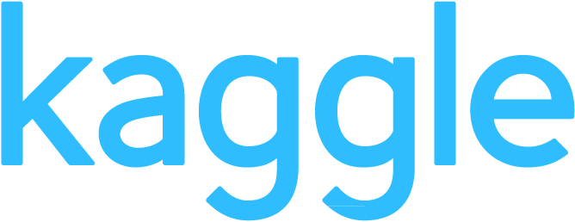
Methodology
KAGGLE
PYTHON
POWER BI
GITHUB
Data Collection
Kaggle is a vast resource offering a wide variety of datasets, enabling seamless data collection
Data Handling
Pandas, NumPy, and Matplotlib enable efficient data cleaning, manipulation, and analysis for key insights
Data Visualization
Power BI is my preferred tool for visualization, offering interactive dashboards that effectively communicate key insights from marketing data
Project Sharing & Collaboration
GitHub offers a centralized platform for version control and collaboration, also serving as a repository for project sharing
This Photo by Unknown Author is licensed under CC BY-SA
This Photo by Unknown Author is licensed under CC BY-SA
This Photo by Unknown Author is licensed under CC BY-NC-ND

Slide 5

Results

Slide 6

Key performance indicators
Metric | Current Status
Revenue | $15,020,000,000
Acquisition Cost | $ 3,000,000,000
Net Profit | $ 1,200,000,000
Average Conversion Rate | 8.01 %
ROI | $ 5.00
Acquired Customers | 9,000,000
Impressions | 1,000,000,000
Clicks | 110,000,000
CTR | 11 %
Campaign Count | 5

Slide 7
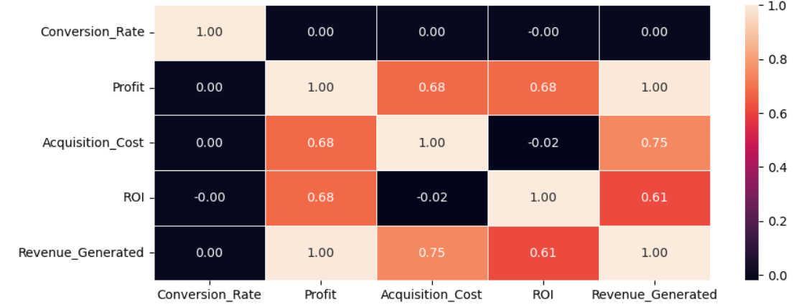
Financial metrics
RESULTS
Acquisition cost and revenue is showing strong correlation by 0.75, indicates as acquisition cost is increasing, revenue increasing.
Acquisition cost and profit is also having moderately strong correlation of 0.68, indicates as acquisition cost increasing, profit increasing.

Slide 8
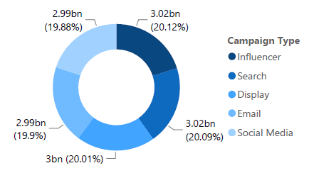
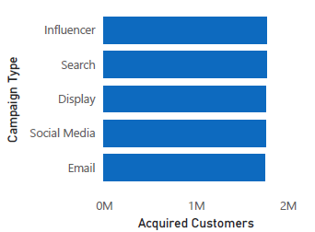
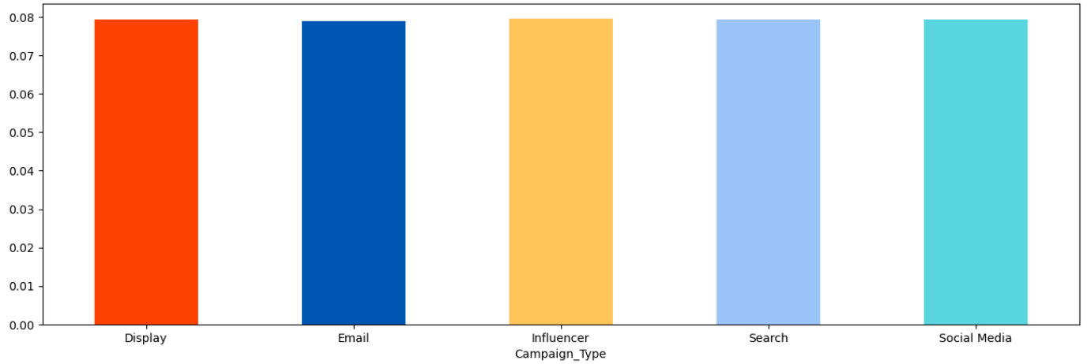
The most trending campaign
RESULTS
The result from the analysis show that Influencer type campaigns are on trends overall from various aspects like revenue generated, acquired customers and conversion rate

Slide 9
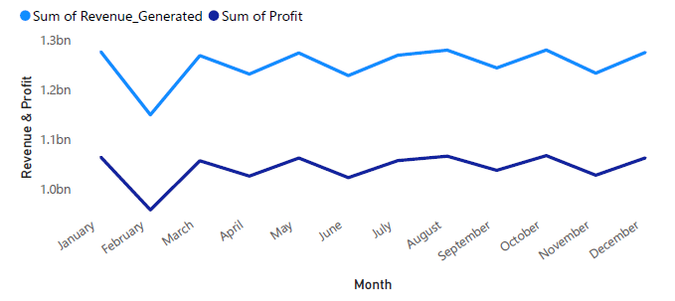
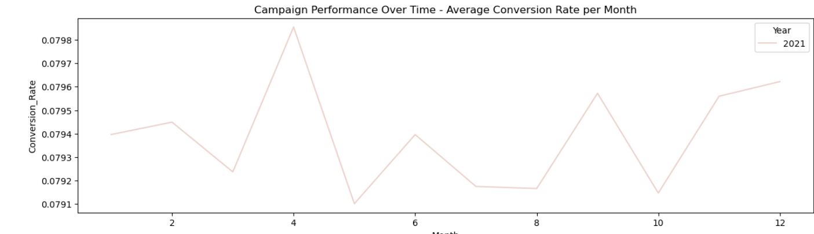
Campaign Performance Over Time
RESULTS
Total Revenue & Profit Generated per Month
Total Revenue Generated per Month
High Significant drop in February; recovery begins in March.
Highest revenue generated in August.
Average Conversion Rate per Month
Fluctuating conversion rates with no clear trend.
Peak in April; lowest in May.
Month-to-month variations without clear seasonal patterns.
Average Conversion Rate Per Month

Slide 10
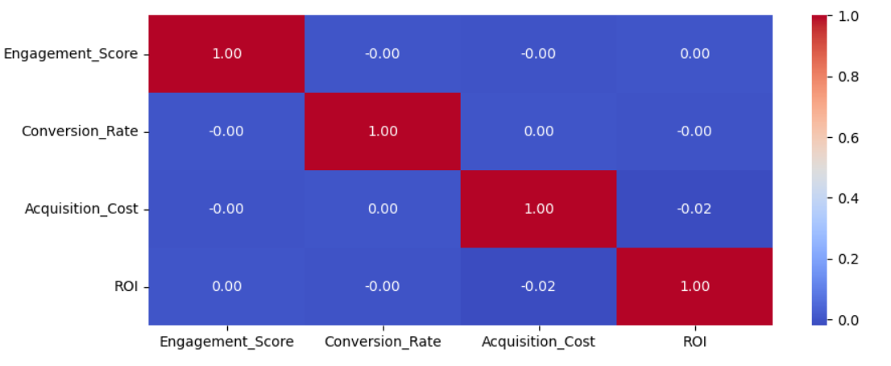
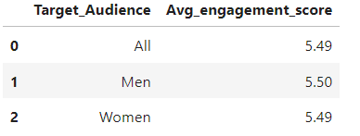
Engagement score analysis
RESULTS
Engagement Score
Vs
Financial
Metrics
Engagement score does not have any impact on financial factors as well as even not on target audience. This indicates that high engagement score does not means increase or decrease in conversion rate. Users just engaging with the campaigns by liking, commenting and sharing does not mean that they will buy or do the signup.
Average
Engagement Score
Vs
Target Audience

Slide 11
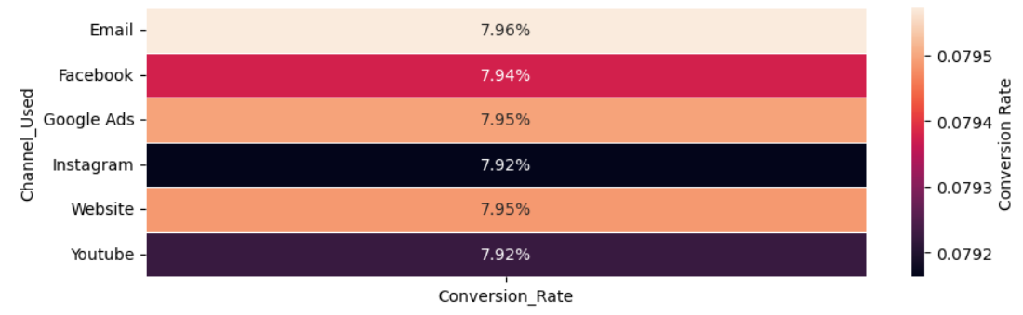
Top channels with most conversion rate
RESULTS
Email is having highest conversion rate of 7.96%, followed by Google Ads and Website both are having 7.95%.

Slide 12

Findings
Trending Campaign Type: Influencer campaigns are trending, driving higher revenue, ROI, and conversion rates.
Top Conversion Channels
Email: 7.96%
Google Ads & Website: 7.95%
Engagement Score Analysis: Engagement score does not correlate with financial outcomes or conversion rates, indicating that likes and shares don’t guarantee purchases.
Effective Campaign & Channel Combinations
Influencer on Email: 8.06% conversion rate
Search on Google Ads: 8% conversion rate
Financial Metrics
Acquisition cost and revenue: Strong correlation (0.75)
Acquisition cost and profit: Moderate correlation (0.68)

Slide 13
Findings
Campaign Performance Trends
Conversion rates fluctuate monthly, peaking in April and dipping in May.
Revenue saw a significant drop in February, with stabilization from March onwards.
Language, Location, & Campaign Impact
Top location: New York (7.95% conversion)
Influencer campaigns perform well across regions, especially English in Los Angeles (8.14%).
Target Audience Insights
Women (25-34) on Email: Highest conversion (8.25%)
Men (18-24) on Website: Strong performance (8.12%)
Top Performing Company
Datatech Solutions: Highest conversion (8.76%) from Women (25-34) using Influencer campaigns on Email.

Slide 14



Suggestions - MARKETING STRATEGIES
Collaborate with influencers to promote products via engaging content on Email and social media platforms.
Implement targeted search campaigns on Google Ads to reach broader demographics, focusing on all age groups
Target Women (25-44) with Influencer campaigns on Email. Explore Search campaigns for all age groups. Focus on Men (18-24) for diverse campaign types.
Plan special promotions during peak months identified (e.g., capitalize on the high conversion rates observed in April).
Tailor campaigns based on location, particularly focusing on high-performing regions like New York and Los Angeles.
Allocate a larger portion of the budget to Influencer campaigns on Email and Search campaigns on Google Ads based on their proven conversion rates.

Slide 15
Conclusion
The campaigns have shown strong financial performance, generating $15.02 billion in revenue with a cost of $3 billion, resulting in an average ROI of 5.00. Key metrics include acquiring 9 million customers, achieving 110 million clicks, and a CTR of 11% with an overall conversion rate of 8.01%.
Influencer campaigns lead with an 8.06% conversion rate on Email and 8% on Google Ads. Notably, Women aged 25-34 have the highest conversion at 8.25%, while Men aged 18-24 perform well at 8.12%.
Company named Datatech Solutions exemplifies success with an 8.76% conversion rate through effective targeting and execution.
Despite success, there's potential for improvement, especially in addressing monthly fluctuations and focusing on conversion over engagement. Strong correlations between acquisition cost and revenue (0.75) suggest room for optimization.

Slide 16




Slide 17


